Slide 1
Contact Manager
Small Project
Group 16

Slide 2
Members
-Jamison Rayfield
-Taharka Zubari
- Jason Taylor
-Justin Lambert
-Cole Silvernail

Slide 3
Project Description

Slide 4
UML Use Case Diagram

Slide 5
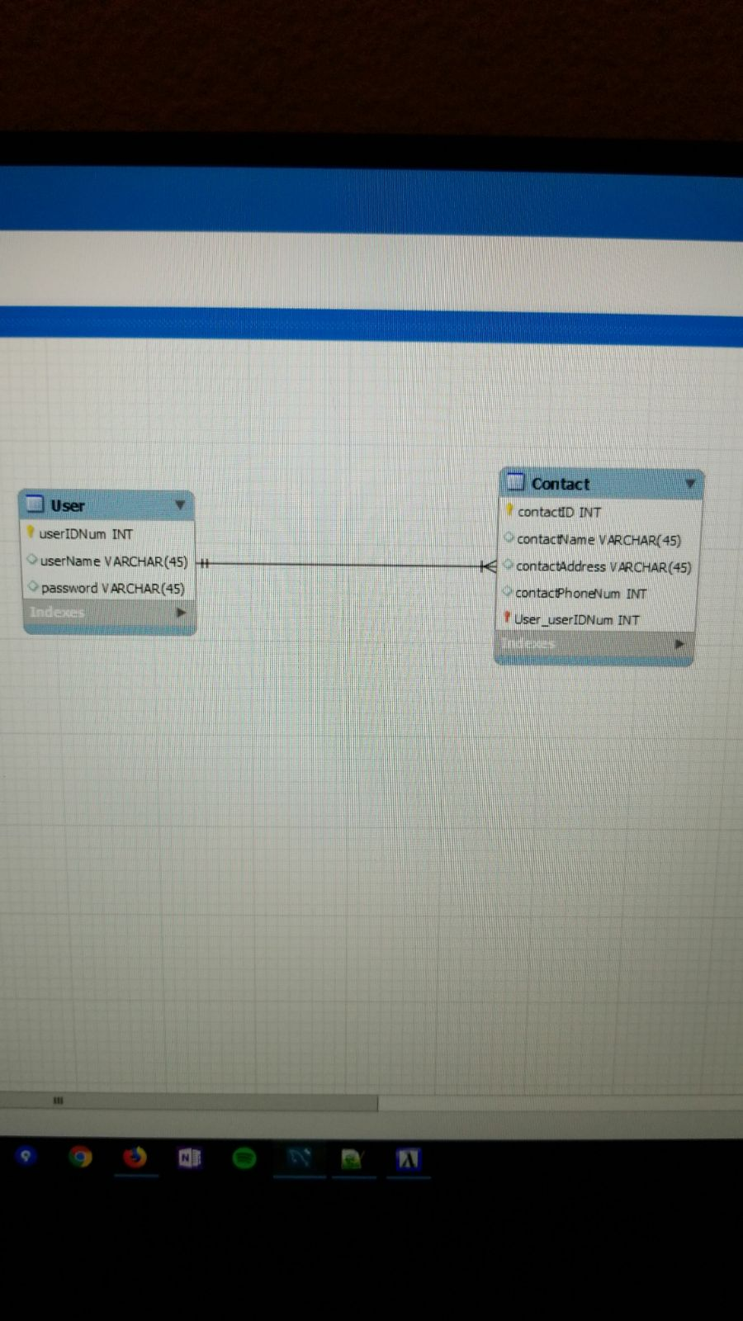
ER diagram (Temporary)

Slide 6
Difficulties
-Switched from WISA to LAMP

Slide 7
Questions

